Slide 1

🎯 Phishing Awareness Training
📘Understanding&
Preventing Online
Attacks
👤 Saptak Biswas 🧩 Intern at CodeAlpha

Slide 2
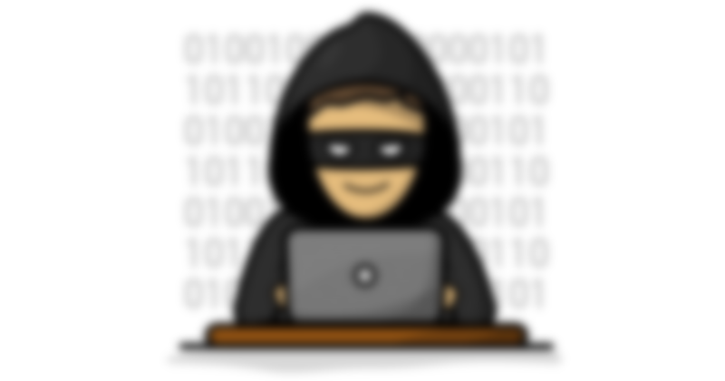


Introduction to Phishing
🔍 What is Phishing?
Phishing is a cybercrime where attackers impersonate legitimate organizations or individuals through emails, messages, or websites to steal sensitive data such as login credentials, credit card numbers, or personal information.
A form of social engineering attack
Delivered via email, SMS, websites, or even calls
Goal: Steal data, install malware, or hijack accounts

Slide 3


Why Phishing is Dangerous
⚠️ Why is Phishing So Dangerous?
📉 Financial Loss: Fraudulent transactions, credit card theft.
🔓 Data Breach: Leaks of personal, organizational, or customer data.
🧠 Identity Theft: Using your name and info for fake accounts.
💻 Malware Infections: Ransomware, keyloggers, spyware.
🧑‍💼 Reputation Damage: Loss of trust in companies or users.
🏢 Corporate Espionage: Stealing business secrets or access credentials.

Slide 4
How Phishing Works (Attack Flow)
🔄 How Phishing Works (Attack Flow)
🧑‍💻 Attacker creates fake email/website.
📧 Victim receives a convincing message.
🔗 Click on fake link or download attachment.
🔐 User enters credentials or runs malware.
🏴‍☠️ Attacker gains access to data/accounts.

Slide 5

Recognizing Phishing Emails
📧 How to Spot a Phishing Email
❌ Unusual Sender Address (e.g. admin@paypaI.com).
📎 Unexpected Attachments or Links.
❗ Urgent/Threatening Language (“Your account will be locked!”).
🔤 Grammatical Errors & Poor Formatting.
🌐 Mismatched URLs (Hover over links → check destination).
This Photo by Unknown Author is licensed under CC BY

Slide 6

Spotting Fake Websites
🌐 How to Identify Fake Websites
🕵️‍♂️ Check the URL carefully (misspelled domains like go0gle.com).
🔒 Look for HTTPS & padlock icon (but don’t rely only on it).
🧱 Low-quality design and poor grammar.
🔗 Pop-ups or forced downloads.
🧪 Use tools like:
Google Safe Browsing
Virustotal

Slide 7

Social Engineering Tactics
🎭 Social Engineering Tactics Used in Phishing
Phishing attackers play with human psychology:
🔑 Common Tricks:
⏳ Urgency: “Your account will be suspended in 1 hour!”.
🎁 Tempting Offers: “You’ve won a free iPhone!”.
🧍 Impersonation: Fake emails from CEO, HR, bank.
🧨 Fear or Threats: "IRS has filed a case against you!“.
🤝 Trust Exploitation: "Reset your password from this link"

Slide 8


Best Practices to Stay Safe
🛡️ How to Protect Yourself from Phishing
✅ DOs:
Hover over links before clicking.
Use two-factor authentication (2FA).
Check sender email and domain carefully.
Keep antivirus and browser up to date.
Report suspicious messages to IT/admin.
❌ DON’Ts:
Don’t click unknown links or attachments.
Don’t trust emails asking for passwords or OTPs.
Never share sensitive info via email/chat.

Slide 9

Real-World Phishing Examples
🌍 Real-World Phishing Attacks
🧪 1. Google Docs Scam (2017):Users received an email “John has shared a doc with you” → clicked link → fake Google login → credentials stolen.
🏦 2. PayPal Fake Alert:“Your PayPal account is on hold” → link led to lookalike login page → card details stolen.
🛑 3. COVID-19 Relief Scams:Government impersonation offering “relief funds” during lockdown → victims gave Aadhaar & bank details

Slide 10
Interactive Quiz – Real or Fake?
🧠 Quick Quiz: Phish or Legit?
❓ Question 1:Email says: “Update your banking info to avoid account suspension.”
Legit
Phish ✅
❓ Question 2:Website URL: https://googIe-security.com
Phish ✅
Legit
❓ Question 3:Email from HR with grammar errors and an attachment named salary_details.exe
Phish ✅
Legit

Slide 11

Key Takeaways
📌 Key Takeaways
🎣 Phishing is a deceptive cyberattack using fake emails/websites.
👀 Always verify links, sender addresses, and attachments.
🧠 Attackers use social engineering to exploit urgency and trust.
🛡️ Use 2FA, update security tools, and report anything suspicious.
🧪 Stay alert — awareness is your best defense

Slide 12

Thank You + Q&A
👤 Presented by: Saptak Biswas
🎓 Intern at CodeAlpha
📩 Email: bsaptak5@gmail.com
🤝 Let’s Stay Safe Online Together!
➡️ Any Questions?
🙏 Thank You!

